Slide 1





Julia Language for Mathematical Programming
Tópico
Mar 2019
Autores:
Erik Alvarez
Jefferson Chávez
Universidade Estadual de Campinas
DSEE – Departamento de Sistemas de Energia Elétrica

Slide 2
JuliaLang?
Open-source & lenguaje de programación libre (MIT license).
Desarrollado a partir del 2012 (por: MIT researchers)
Creciente popularidad a nivel mundial, en investigación, data science, finanzas, etc.
Multi-platform: Windows, Mac OS X, GNU/Linux…
Diseño para la performance:
Interpretador & compilador, muy eficiente
Fácil de run codes en paralelo (multi-core & cluster)
Diseño para ser simple de aprender y usar:
Easy sintax, dynamic typing (como MATLAB & Python)

Slide 3


Referencias
Link: Home · The Julia Language
Link: Introduction · JuMP
Link: GLPK - GNU Project - Free Software Foundation (FSF)
Link: Introduction to IPOPT: A tutorial for downloading, installing, and using IPOPT

Slide 4


Julia vs. MATLAB: General
 | Julia | MATLAB
Cost | Free | Hundreds of €/$ per year
License | Open-source | 1 year user license
Comes from | A non-profit foundation, and the community | Mathworks Company
Editor/IDE | Jupyter and Atom/Juno are recommend | Good IDE already included
Parallel computations | Very esasy, low overhead cost | Possible, high overhead
Usage | Generic, worldwide | Research in academy and industry
Fame | Young but starts to be known | Old and known

Slide 5
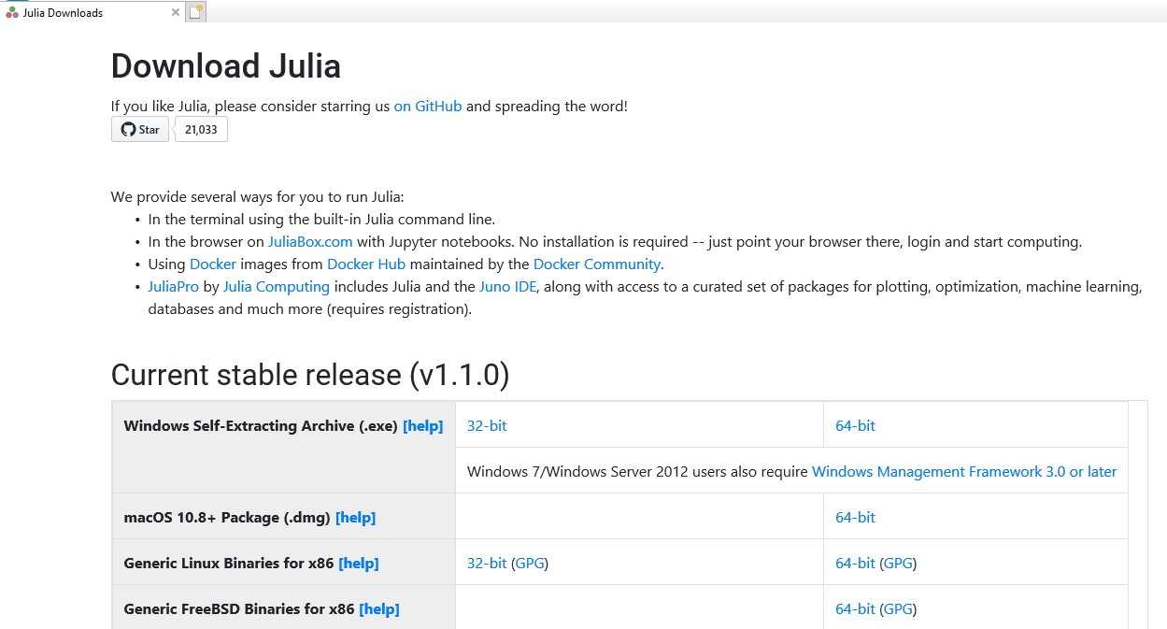
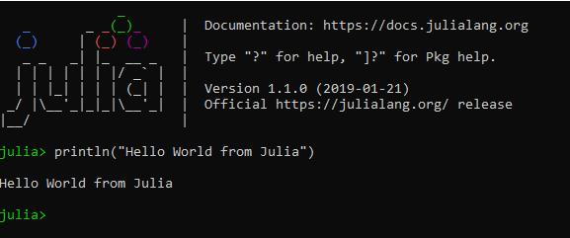
Instalación (1/3)
Para Linux, Mac OS o Windows.
Se puede descargar el instalador JuliaLang en: Julia Downloads
Atom se puede descargar de: Atom
Descarga e instalar Julia con default settings.
Abrir Julia

Slide 6
Instalación (2/3)
En Julia: Crtl + tecla “}” para establecer el (v1.1) pkg>
En: (v1.1) pkg> add JuMP
En: (v1.1) pkg> add GLPK
En: (v1.1) pkg> build GLPK
Apretar tecla “backspace” : julia>
En: julia> using JuMP
En: julia> using GLPK
En: julia> using GLPK
En: (v1.1) pkg> add Ipopt
En: (v1.1) pkg> build Ipopt
En: julia> using Ipopt
En: (v1.1) pkg> status

Slide 7
Instalación (3/3)
Descarga e instalar Julia con default settings.
In Atom, ir a Settings (Ctrl+,, or Cmd+, on macOS) e ir al "Install" panel.
Escribir uber-juno en la sección de busqueda y apretar tecla Enter. Dar click en el boton install de la librería.
Atom instalará y configurará Juno por ti.

Slide 8
Descripción general de los famosos “Packages” de Julia
Plotting:
Winston.jl para plotear comoMATLAB
PyPlot.jl , interfaz al Matplotlib (Python)
JuliaDiffEq.jl , para ecuacioanes diferenciales
JuliaStats.jl , para estadistica
JuliaDSP , para procesamiento de señales
BackpropNeuralNet, para redes neuronales
JuliaOpt/JuMP para optimización
Más “Packages” en: Julia Package Listing

Slide 9
Julia vs. MATLAB: Syntax
 | Julia | MATLAB
File ext. | .jl | .m
Comment | # blabla… | % blabla…
Indexing | a[1] to a[end] | a(1) to a(end)
Slicing | a[1:100] | a(1:100)
Operations | Linear Algebra special library | Linear Algebra by default
Block | Use end to close all blocks | Use endif, endfor etc
And | a & b | a && b
Or | a | b | a || b
Array | [1 2; 3 4] | [1 2; 3 4]

Slide 10
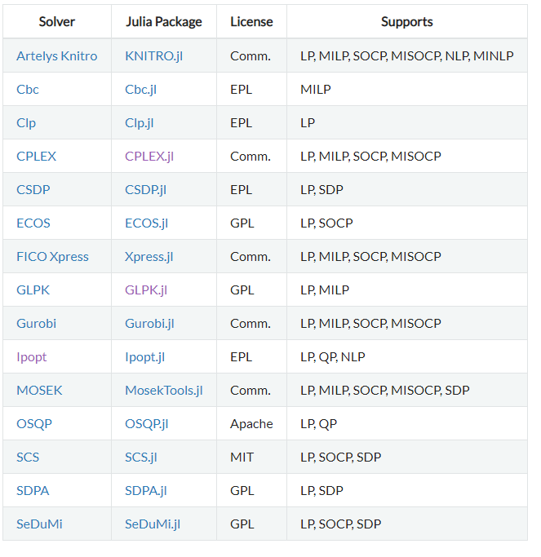
JuMP
JuMP package: lenguaje de modelamiento para optimización
Interfaces de JuMP con solver de optimización:
Donde:
LP: Linear Programming
QP:Quadratic Programming
SOCP = Second-order conic programming (including problems with convex quadratic constraints and/or objective)
MILP = Mixed-integer linear programming
NLP = Nonlinear programming
MINLP = Mixed-integer nonlinear programming
SDP = Semidefinite programming
MISDP = Mixed-integer semidefinite programming
Otros leguajes de modelamiento:
AMPL
GAMS
MATLAB: YALMIP,CVX
Python: Pyomo, PuLP, CVXPy

Slide 11
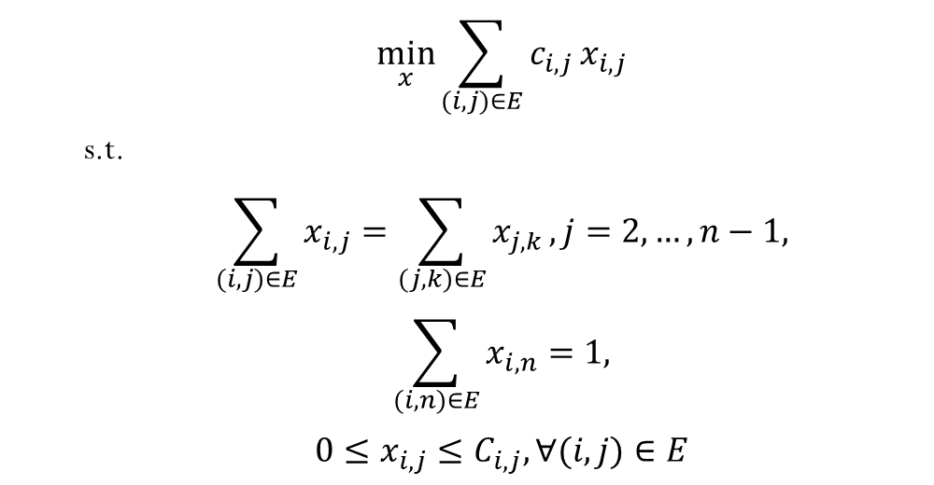
JuMP: Comparaciones “syntax” (1/2)
 | $$\min_{x}{\sum_{(i,j)∈E}{c_{i,j}}x_{i,j}}$$
 | s.t.
 | $$\sum_{(i,j)∈E}{x_{i,j}}=\sum_{(j,k)∈E}{x_{j,k}}, j=2,…,n−1,$$
 | $$\sum_{(i,n)∈E}{x_{i,n}}=1,$$
 | $$0≤x_{i,j}≤C_{i,j}, ∀(i,j)∈E$$

Slide 12
JuMP: Comparaciones “syntax” (1/2)
JuMP
immutable Edge
from; to; cost; capacity
end
edges = [Edge(1,2,1,0.5), Edge(1,3,2,0.4), Edge(1,4,3,0.6),
Edge(2,5,2,0.3), Edge(3,5,2,0.6), Edge(4,5,2,0.5)]
Mcf = Model()
@variable(mcf, 0 <= flow[e in edges] <= e.capacity
@constraint(mcf, sum{flow[e], e in edges, e.to==5} == 1)
@constraint(mcf, flowcon[n=2:4], sum{flow[e], e in edges; e.to==node}
== sum{flow[e], e in edges; e.from==node})
@objective(mcf, Min, sum{e.cost * flow[e], e in edges})
AMPL
set edges := {(1,2),(1,3),(1,4),(2,5),(3,5),(4,5)};
param cost{edges}; param capacity{edges};
data ...; # Data es alamacenada separadamente en AMPL;
var flow{(i,j) in edges} >= 0.0, <= capacity[i,j];
subject to unitflow: sum{(i,5) in edges} flow[i,5] == 1;
subject to flowconserve {n in 2..4}:
sum{(i,n) in edges} flow[i,n] == sum{(n,j) in edges} flow[n,j];
minimize flowcost: sum{(i,j) in edges} cost[i,j] * flow[i,j];

Slide 13
JuMP: Comparaciones “syntax” (2/2)
Pyomo
edges = [(1,2), (1,3), (1,4), (2,5), (3,5), (4,5)]
cost = {(1,2):1, (1,3):2, (1,4):3, (2,5):2, (3,5):2, (4,5):2}
capacity = {(1,2):0.5, (1,3):0.4, (1,4):0.6, (2,5):0.3, (3,5):0.6, (4,5):0.5}
mcf = ConcreteModel()
mcf.flow = Var(edges, bounds=lambda m,i,j: (0,capacity[(i,j)]))
mcf.uf = Constraint(expr=sum(mcf.flow[e] for e in edges if e[1]==5) == 1)
def con_rule(mcf,n): return sum(mcf.flow[e] for e in edges if e[1]==n) ==
sum(mcf.flow[e] for e in edges if e[0]==n)
mcf.flowcon = Constraint([2,3,4],rule=con_rule)
mcf.flowcost = Objective(expr=sum(cost[e]*mcf.flow[e] for e in edges))
GAMS
SET nodes /n1*n5/; SET midnodes(nodes) /n2*n4/; SET lastnode(nodes) /n5/;
ALIAS(nodes,nodefrom,nodeto,n);
SET edges(nodes,nodes) / n1.n2 n1.n3 n1.n4 n2.n5 n3.n5 n4.n5 /;
PARAMETER cost(nodes,nodes) / ... /; * Data omitted
PARAMETER capacity(nodes,nodes) / ... /; * for space reasons
POSITIVE VARIABLE flow(nodefrom,nodeto); flow.UP(edges) = capacity(edges);
EQUATION unitflow;
unitflow.. sum{edges(nodefrom,lastnode), flow(nodefrom,lastnode)} =e= 1;
EQUATION flowcon(nodes);
flowcon(midnodes(n)).. sum{edges(nodefrom,n), flow(nodefrom,n)} =e=
sum{edges(n,nodeto), flow(n,nodeto)};
FREE VARIABLE obj;
EQUATION flowcost; flowcost.. obj =e= sum{edges, cost(edges)*flow(edges)};
MODEL mincostflow /all/; SOLVE mincostflow USING lp MINIMIZING obj;

Slide 14
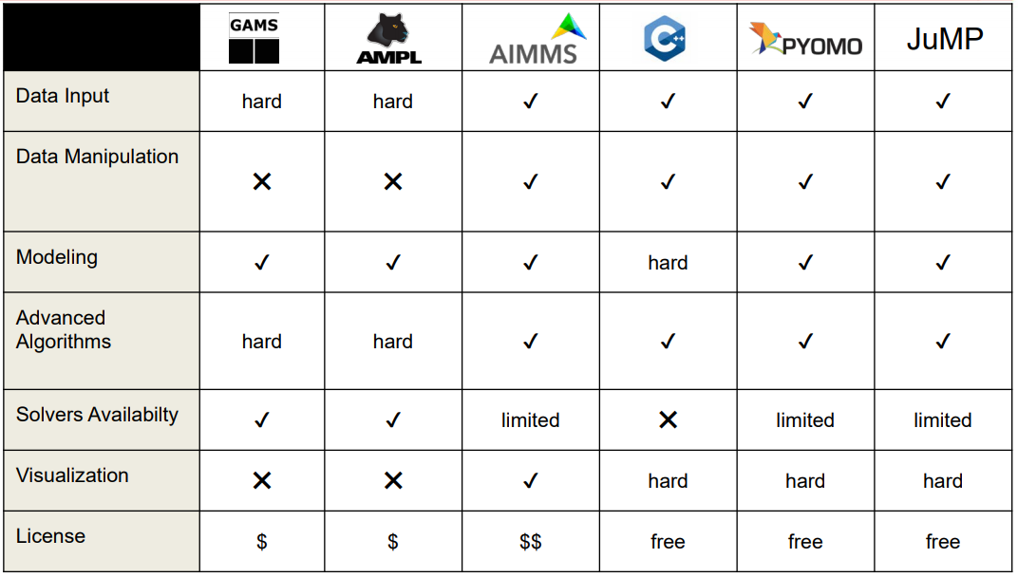
JuMP: Pro & Cons (1/2)

Slide 15
JuMP: Pro & Cons (2/2)
Pros
Nuevo lenguaje de modelamiento
Muy rápido
Open-source
Facil y simple de codificar
Acceso a C/C++
Respaldado por una amplia comunidad científica
Amplia variedad de librerías
Cons
Nuevo lenguaje de modelamiento
Muchas librerías y plataformas aun en desarrollo
Poco conocido

Slide 16

JuMP: Quiénes aplican en mercados eléctricos?
Ministerio de Energía y Minas

Slide 17

“The new becomes old, and the old becomes new…a life cycle”

